Slide 1
ALASKA AIRLINE
Name
Institution Affiliation
Date

Slide 2
Competitors of Alaska airline
Regional competition
The regional competitor is Us airways.
The airline has high competition on Alaska airline since they provide incentives like free annual tickets and subsidizing flights after some period therefore attracting more customers compared to Alaska airline posing a major threat in the region.
Notes:
Alaska airways’ reginal competitor is US airways it competitive ability is due to the incentives they offer such as free tickets.

Slide 3
National competitor
JetBlue airline is the major national competitor.
The JetBlue airline is the national competitor of the Alaska airline where it has low cost carrier and has high customers satisfaction.
Regardless of the low carrier cost they are able to make high profits.
Notes:
JetBlue is the national competitor and poses a threat due to its low fight charges .

Slide 4
Global competitor
SkyWest is the global threat to Alaska airline
Alaska airways in the sole operator regardless of having a high financial stability that sky west airline .it faces competition from SkyWest because of the partnership that they have with other air carriers .
Notes:
SkyWest are the global competitors of Alaska airways due to its partnership with other carriers .

Slide 5
Airline alliances
The Alaska airline is a non-members in the airline alliance which makes the airline unpredictable incase they make loses they will not be able to get back to the track.
Alaska airline is not a member of the lucrative Asian market.
Notes:
Alaska airways is not involved in any airline alliances and are not even members of lucrative Asian market.

Slide 6
Partnership relationship with Alaska airline
Alaska airline is in partnership with other airline companies. Example
British airways
Aeromexico
Cathay pacific
Fiji airline
American airways
Emirates airline
Singapore airline
Notes:
Alaska airline has partnerships with other airlines such as American airways.

Slide 7
The aim of Alaska airline partnership American airline :
Allow customers to books any of the two network platforms .
Chasing high spending technology .
Allow travelers to burn and earn miles on their partners flight.
Notes:
Aim of partnership is to enhance network platforms ,chasing spending technology and allowing traveler's to burn and earn miles on their partner's flight.

Slide 8
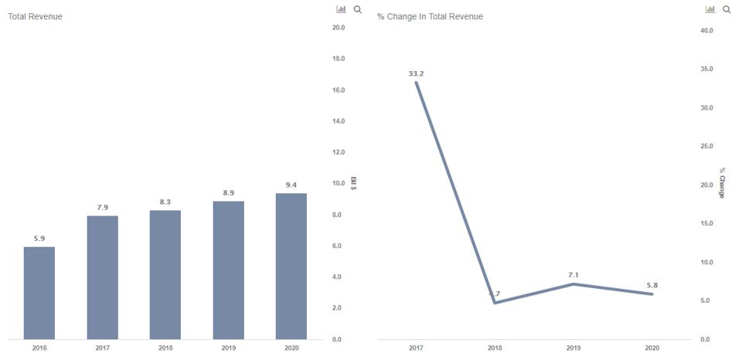
Performance of Alaska airline
Notes:
Performance chart

Slide 9
Performance of Alaska airline
Alaska airline has been having an increase in the sales and revenue since the year 2015 each year having an increase .
There have been a steady increase in the cost of ware and tear
Increase in the levels of depreciations.
These aspects have increased the expenses and regardless of that fact the company has been making good profits for their last 5 years.
Notes:
Alaska airline is making profits in the last five years regardless of their increase in spending.

Slide 10
Cash flow
Alaska mile costs 27.50 dollars for each increase by a thousand miles.
Pre-tax cost is 2.75 cents for every mile.
Revenue per available seat miles of Alaska is 66.6 billion dollars.
Alaska earns a profit of 2cents per mile.
Alaska airline has been also increasing profitability from cargo operations.
There have been an increase in the load factor in the past five years due to the rise in numbers of travelers and changes in consumer experience in favor of Alaska airline.
Notes:
Cost per available seat miles ,revenue per available seat and load factors have been increasing for the last five years .

Slide 11
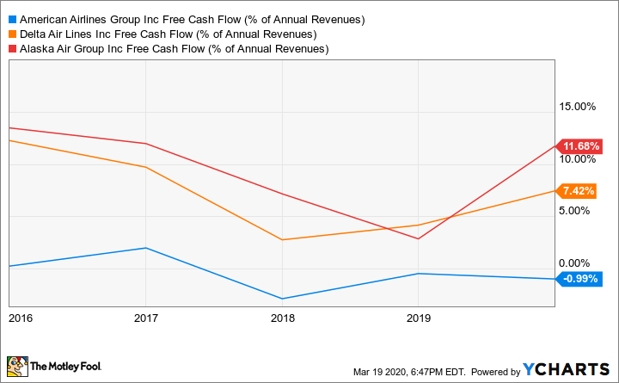
Cash flow chart
Notes:
Chart on cash flow in Alaska airline .

Slide 12
References
Alaska Airlines https://www.alaskaair.com/
Komarnisky, S. (2018). The Annual Migration of the Traveling Swallows: SHARED EXPERIENCES OF MOBILITY ACROSS NORTH AMERICA. In Mexicans in Alaska: An Ethnography of Mobility, Place, and Transnational Life (pp. 45-74). Lincoln; London: University of Nebraska Press.
OWEN, R. (2013). Mobilizing Air Transport for Global War. In Air Mobility: A Brief History of the American Experience (pp. 26-32). University of Nebraska Press.
Ringsmuth, K. (2015). Conclusion: WHERE HAVE ALL THE SKY BOYS GONE? In Alaska's Sky boys: Cowboy Pilots and the Myth of the Last Frontier (pp. 189-200). Seattle; London: University of Washington Press.
Spencer, A. (2020). THE FORMATION OF THE ROYAL AUSTRALIAN AIR FORCE AND THE FIRST REASSESSMENTS OF PACIFIC DEFENSES, 1920–1921. In British Imperial Air Power: The Royal Air Forces and the Defense of Australia and New Zealand Between the World Wars (pp. 37-52). West Lafayette, Indiana: Purdue University Press. doi:10.2307/j.ctvs1g9m2.5
Notes:
References

